Slide 1
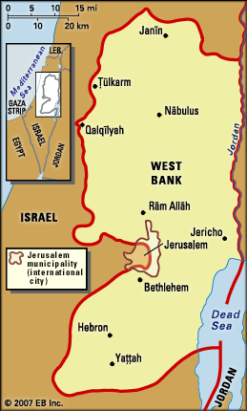
100 bp
Marker
Primer set A
Primer set B
Primer set C
1,500
1,200
1,000
500
mix only
9382
9384
9385
9386
9387
9388
mix only
9382
9384
9385
9386
9387
9388
mix only
9382
9384
9385
9386
9387
9388
PCR enzyme: Lamda biotech
2X master mix, D123P
Extension changed to 72°C
10 μl loaded into the gel
marker: Fermentas, SM0322
2 μl loaded into the gel
All other steps were the same as in the protocol given
9382 - Jericho
9384 - Jenin
9385 - Tulkarm
9386 - Salfit
9387 - Ramallah
9388 - Qalqilyah

Slide 2
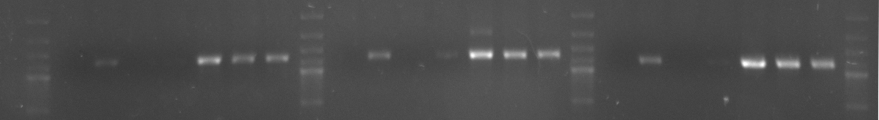
100 bp
Marker
Primer set A
Primer set B
Primer set C
1,500
1,200
1,000
500
mix only
9382
9384
9385
9386
9387
9388
mix only
9382
9384
9385
9386
9387
9388
mix only
9382
9384
9385
9386
9387
9388
Second run
New PCR from the same samples

